Slide 1
SUDOKU QUEST
CS 101 PROJECT 2015
MITHUN OBULAMPALLI (140040107)
MAMIDI REVANTH RAJ (140040094)
BOLLU YASHWANTH KUMAR (140010044)
HARVEER SINGH J (140100057)
TEAM ID 221

Slide 2
Problem Statement:
It is a single player game which tests the logic of the user.
Sudoku originally called number place is a logic based number-placement puzzle.
The objective is to fill a 9x9 grid with digits so that each row, each column and each of the nine 3x3 sub-grids that composes the grid contains all the digits from 1 to 9.

Slide 3
GAME DESCRIPTION:
Sudoku Auto Solver
Sudoku Generator
Sudoku
QUEST

Slide 4
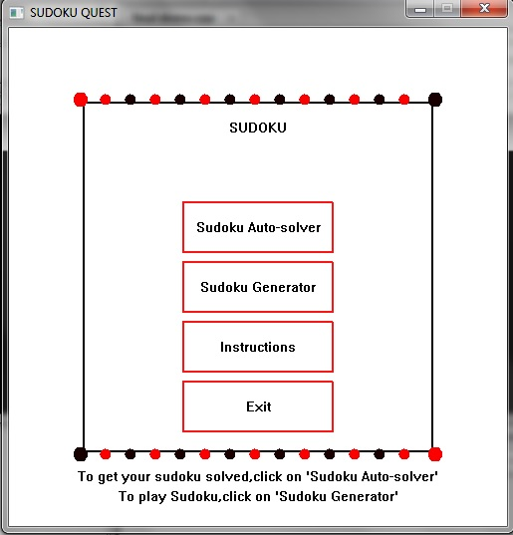
Working of the Game:
The home screen of the game when it opens

Slide 5
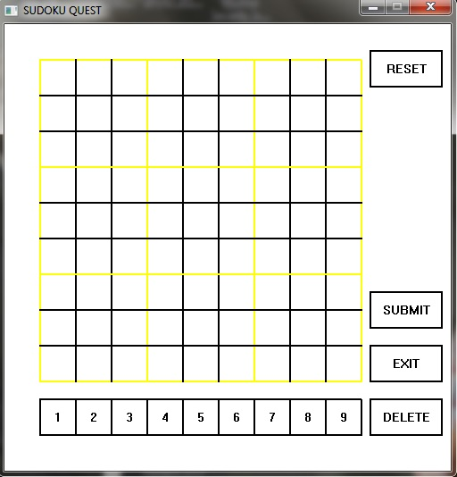
Working of the Game:
Sudoku Auto
Solver

Slide 6
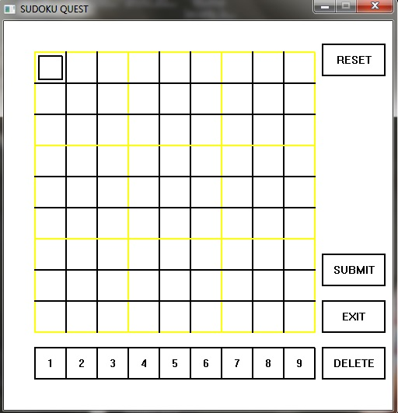
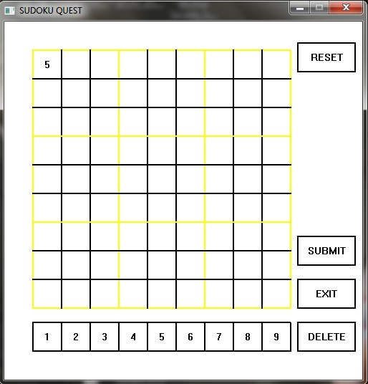
Working of the Game:

Slide 7
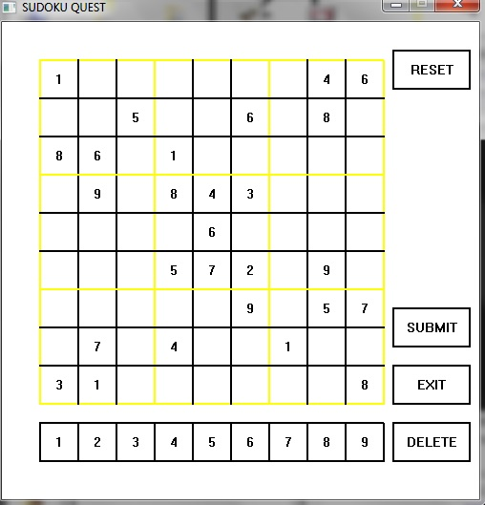
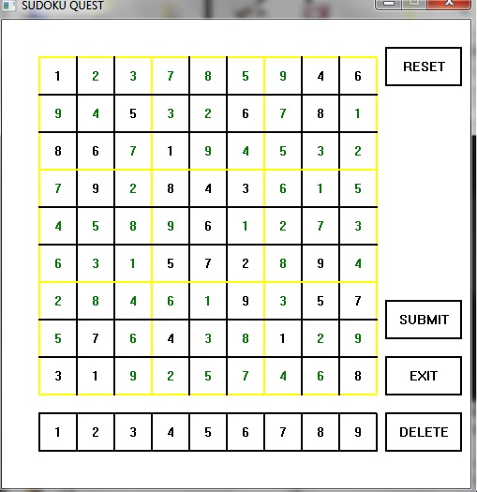
Working of the Game:

Slide 8
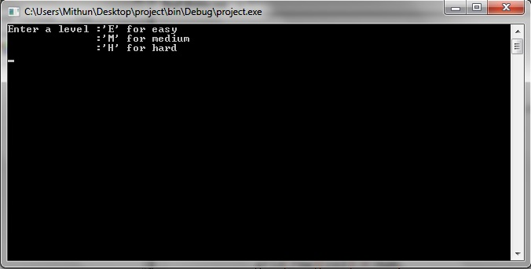
Game Description:
Sudoku Generator
Choosing Sudoku Generator enables the user to choose three different levels namely Easy, Medium and Hard.

Slide 9
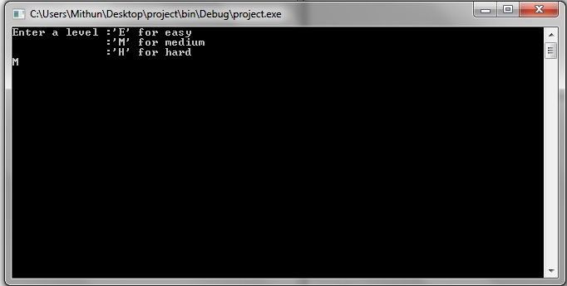
Working of the Game
The user has to type in the letters ‘E’ , ‘M’ or ‘H’ to choose Easy ,Medium or Hard levels respectively.

Slide 10
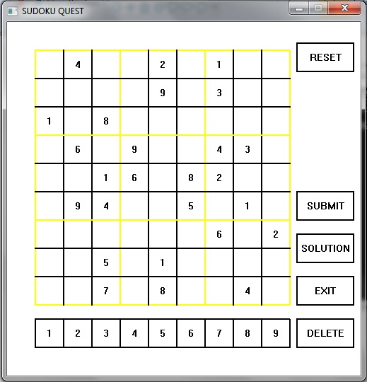
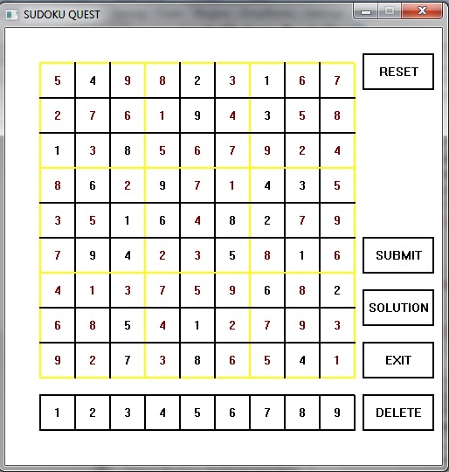
Working of the Game:

Slide 11
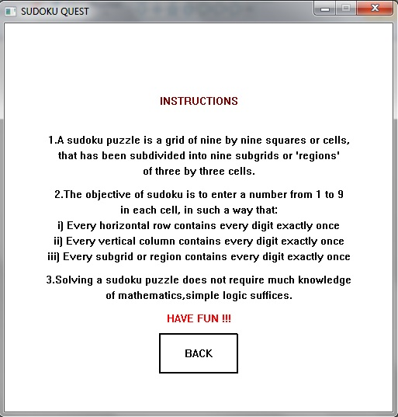
Working of the Game:

Slide 12
Challenges:
Implementing backtracking to solve puzzles
Creating the interface
Opening the preloaded Sudoku onto the canvas
Defining the features in the canvas window

Slide 13
Future Work:
As it is a puzzle game, the levels can be increased and also the variants such as using letters instead of numbers or even parts of a picture i.e., basically impending more constraints.
The shapes of the standard 3x3 sub-grids can also be changed.
The user interface as well as the puzzle can be made more graphical.
Backtracking algorithm can be used in Logic programming languages

Slide 14

Link to our spoken video tutorial: https://www.youtube.com/watch?v=cm9vTAjV1oY

